Slide 1

Ashland Daily Photo
http://traveljapanblog.com/ashland/2012/08/portland-oregon-from-the-air/

Slide 2
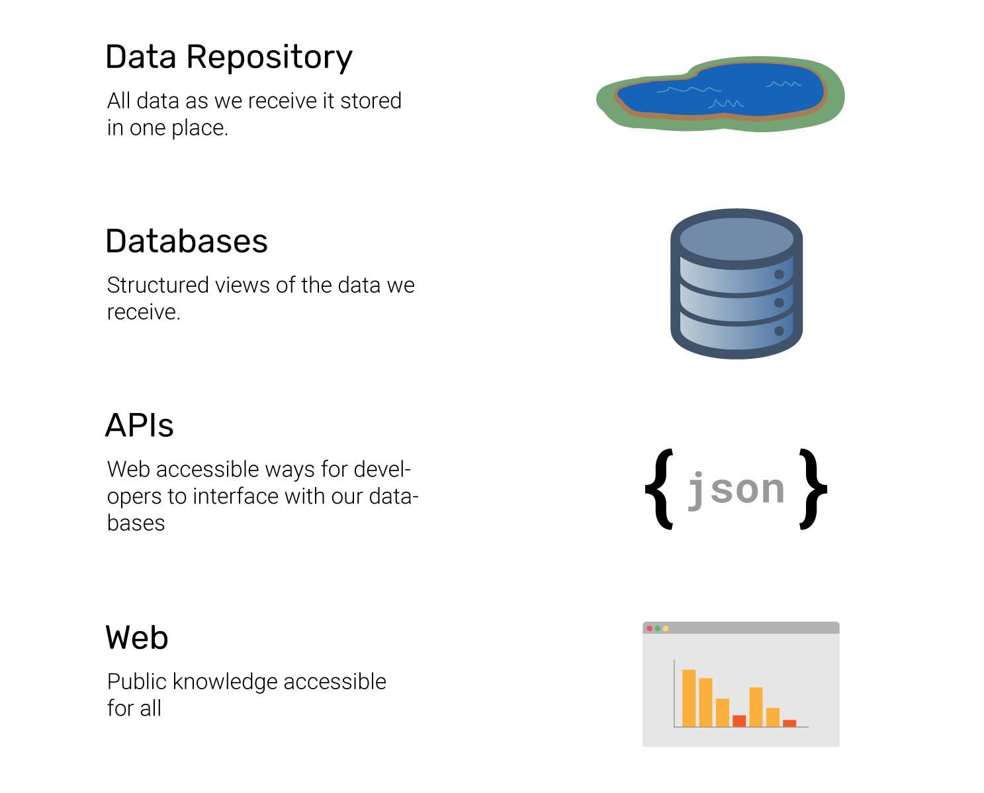

Slide 3
Django Rest Framework, API Development, and Tooling

Slide 4
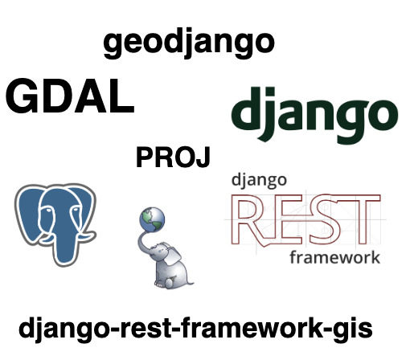

Slide 5
High-level takeaways
Development pattern/what are we building?
Workflow overview
Project creation with cookiecutter
API development with Django Rest Framework
GIS Support (GeoDjango, django-rest-framework-gis, PostGIS)
Tools/Deployment

Slide 6
What are we doing?
Hack Oregon doesn’t just build apps, we build systems.
  APIs provide a public facing gateway to our data
  Our APIs will power our front end applications as well as future data science
We work with Django as our web framework
  “Batteries included model”
3rd party Django Rest Framework applications
  Third Party Packages allow developers to share code that extends the functionality of Django REST framework, in order to support additional use-cases
  Installable through a package repository

Slide 7
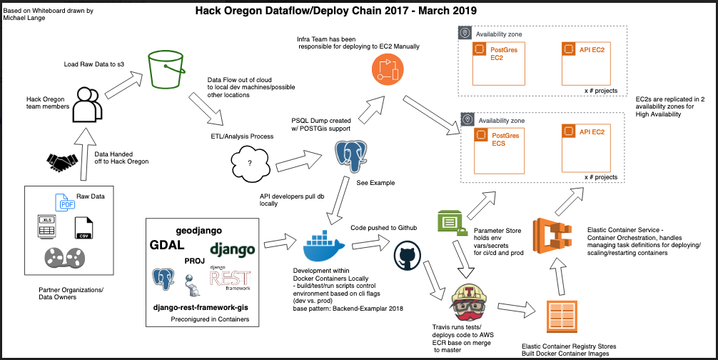
A look at our existing deployment chain ...

Slide 8
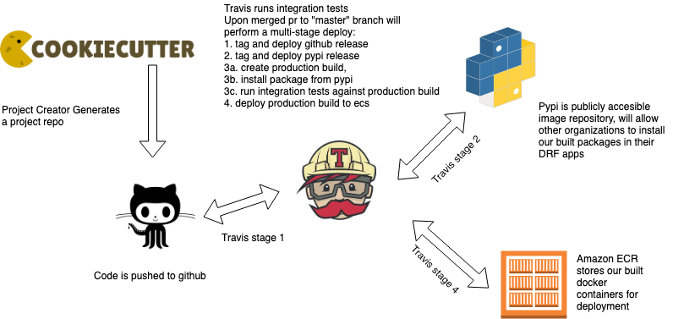
API Deployment Quickview

Slide 9

Cookiecutter
Cookiecutter is a templating engine
Simplifies our process of building APIs and distributable packages
  Provides boilerplate and development tooling w/minimal configuration
  Help developers get up and coding faster

Slide 10


Create a Project
Create git repo
cd <cookiecutter-repo-directory>
git init
Create a remote repo in Hack Oregon organization (matching the “github_repo” template value
Make initial commit
git remote add origin <repo url>
git add .
git commit -m "initial commit"
git push origin master
Make new branch
git checkout -b cool-new-feature
Create .env and set
cp env.sample .env
Build container
./bin/build.sh -d
Start container
./bin/start.sh -d
Open url in browser
api_1 | [2019-05-18 16:59:44 +0000] [26] [INFO] Listening at: http://0.0.0.0:8000 (26)
Start coding
Install cookiecutter
pip install cookiecutter
Use cookiecutter to create repo from github template
cookiecutter gh:hackoregon/2019-backend-cookiecutter-django
Follow prompts to fill in templates

Slide 11
Project Naming Conventions
hack_oregon_team - what project/theme team you are working on
Ex: Transportation Systems
python_package_namespace - this should generally be: hackoregon_< your team>
Ex: hackoregon_transportation_systems
python_subpackage - name of the more specific application/module you are developing. Should generally be able to stand alone as individual/reusable package of code, though can pull in other packages as dependencies
Ex: passenger_census, toad, biketown
*you may have more than one subpackage, but this cookiecutter will spin up first one automagically. A pattern for adding additional subpackages will be provided

Slide 12
Project Naming Conventions
version - you will generally start with 0.1.0 as a first version, with version 1.X being the production/demo day release (we will provide more info on versioning)
gis - whether this project should include django-rest-framework-gis package as a dependency (can be added later manually by updating setup.py)
Ex: True or False
"data_science_repo_url" - URL of repo where team data science work is contained "data_science_repo_name" - Name of repo where data science work is contained

Slide 13
Create a Project (Demo)
Create git repo
cd <cookiecutter-repo-directory>
git init
Create a remote repo in Hack Oregon organization (matching the “github_repo” template value
Make initial commit
git remote add origin <repo url>
git add .
git commit -m "initial commit"
git push origin master
Make new branch
git checkout -b cool-new-feature
Create .env and set
cp env.sample .env
Build container
./bin/build.sh -d
Start container
./bin/start.sh -d
Open url in browser
api_1 | [2019-05-18 16:59:44 +0000] [26] [INFO] Listening at: http://0.0.0.0:8000 (26)
Start coding
Install cookiecutter
pip install cookiecutter
Use cookiecutter to create repo from github template
cookiecutter gh:hackoregon/2019-backend-cookiecutter-django
Follow prompts to fill in templates

Slide 14
Join a Project
Clone the repo
git clone <github-repo-url>
Make new branch
git checkout -b cool-new-feature
Create .env and set
cp env.sample .env
Build container
./bin/build.sh -d
Start container
./bin/start.sh -d
Open url in browser
api_1 | [2019-05-18 16:59:44 +0000] [26] [INFO] Listening at: http://0.0.0.0:8000 (26)
Start coding

Slide 15
2019-backend-cookiecutter-django
Let’s look at the template
Base README, LICENSE, contribution, ignore files…
Dockerfile and docker-compose
.travis.yml
Pytest configuration
Pypi deployment
Local_settings and api configuration

Slide 16
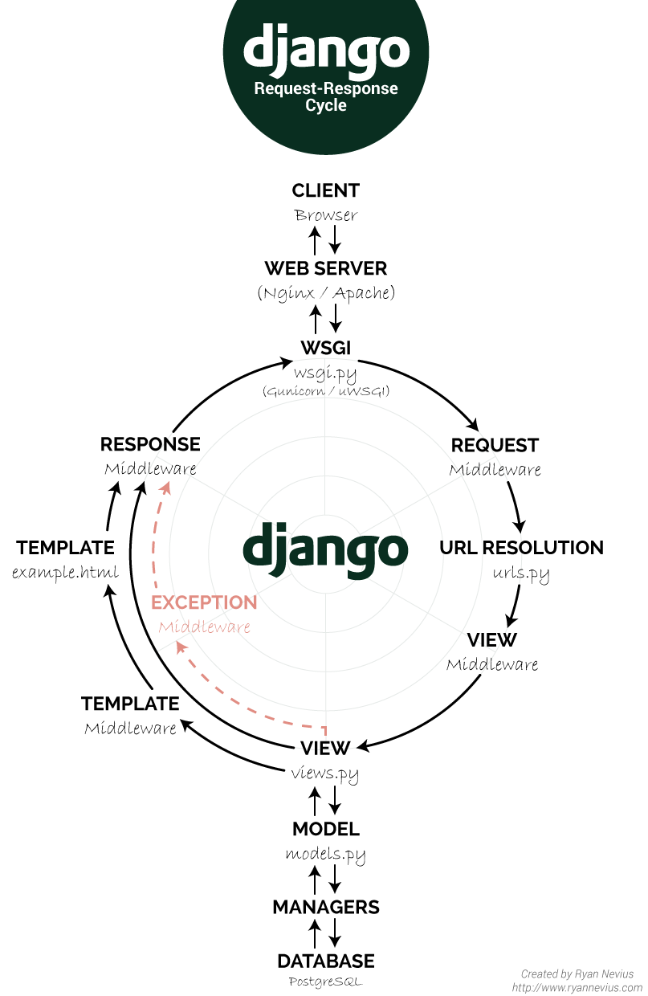
Building an API
Django Rest Framework APIs
  Configuration
  Testing
  Models
  Serializers
  Views/Viewsets
  Routes
Other Concepts
  Filtering
  Pagination
  Status codes/exceptions
whitenoise is used in place of Web Server in this context
DRF uses serializers to serve json data
Does not use templates directly outside of swagger frontend

Slide 17
Building an API - Configuration
Django Configuration
  Configured in the settings.py file
Docker project provides some basic configuration
  https://github.com/hackoregon/2019-backend-docker/blob/staging/backend/hacko_settings.py
You can override in local project
  https://github.com/hackoregon/2019-backend-cookiecutter-django/blob/fixed/%7B%7Bcookiecutter.github_repo%7D%7D/local_settings/settings.py
Objects need to be “set” in total, cannot append
  Important to include all “installed apps” in you local settings
We are configured to use whitenoise for static hosting/Gunicorn for web server
“Debug” variable

Slide 18
Building an API - Testing
Pytest-django
Coverage
Live Tests (against production database)
  Configuration to prevent tear down/change of production data
  Works locally and in travis
  https://www.django-rest-framework.org/api-guide/testing/#live-tests
Test your code, not Django ORM
APIClient
  Test api request/response
  Status codes
  Logic
More resiliant code against updates/changes

Slide 19
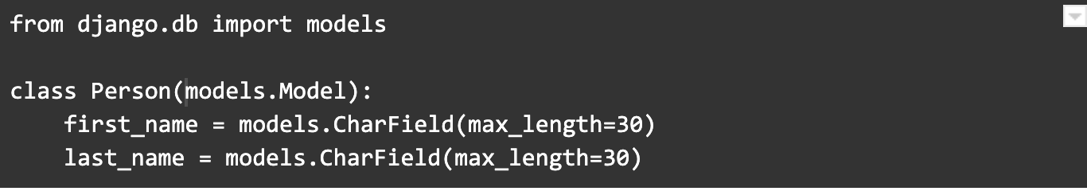
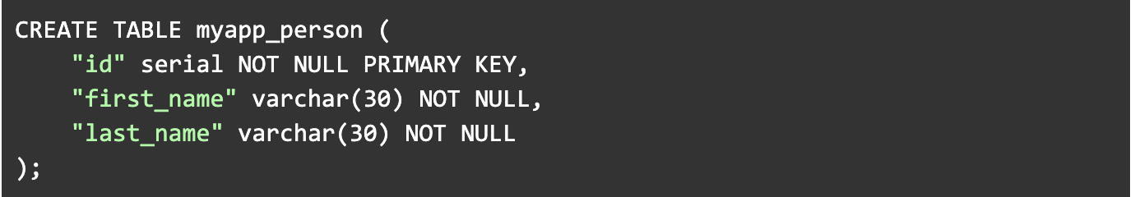
Building an API - Models
A model is the single, definitive source of information about your data. It contains the essential fields and behaviors of the data you’re storing. Generally, each model maps to a single database table.
The above Person model would create a database table like this:

Slide 20
Building an API - Models
Auto-generation of model from an existing database (run in docker interactive shell)
docker exec -it <docker-container> bash
python manage.py inspectdb > <namespace>/<subpackage>/models.py
Gets you part-way there
  Validate data types
  Check relationships
  If using multi-database router:
    import django.db.models.options as options
    options.DEFAULT_NAMES = options.DEFAULT_NAMES + ('in_db',)
  Add to meta fields:
    in_db = 'passenger_census'

Slide 21
Building an API - Models (Demo)
class PassengerCensus(models.Model):
summary_begin_date = models.DateField(blank=True, null=True)
route_number = models.IntegerField(blank=True, null=True)
direction = models.IntegerField(blank=True, null=True)
service_key = models.TextField(blank=True, null=True)
stop_seq = models.IntegerField(blank=True, null=True)
location_id = models.IntegerField(blank=True, null=True)
public_location_description = models.TextField(blank=True, null=True)
ons = models.IntegerField(blank=True, null=True)
offs = models.IntegerField(blank=True, null=True)
x_coord = models.FloatField(blank=True, null=True)
y_coord = models.FloatField(blank=True, null=True)
geom_4326 = models.GeometryField(blank=True, null=True)
census_block = models.CharField(max_length=255, blank=True, null=True)
class Meta:
managed = False
db_table = 'passenger_census'
in_db = 'passenger_census'

Slide 22
Building an API - Serializers
Serializer fields handle converting between primitive values and internal datatypes. They also deal with validating input values, as well as retrieving and setting the values from their parent objects.
Can be very simple:
  class AnnualRouteRidershipSerializer(serializers.ModelSerializer):
  class Meta:
  model = AnnualRouteRidership
  fields = '__all__'
Use the “ModelSerializer” when working with serializers which meet up with models (or “GeoFeatureModelSerializer”, more on this later)
Can specify only specific fields (via “fields”), but can also customize/add fields using the serializer fields (important when creating more custom views)
If serializer is returning more then one object, then set many=True
Relationships generally look at the primary key, but you can provide more control/also set depth

Slide 23
Building an API - Serializers (Demo)
class PassengerCensusSerializer(serializers.GeoFeatureModelSerializer):
class Meta:
model = PassengerCensus
geo_field = 'geom_4326'
id = 'id'
fields = '__all__'
class PassengerCensusInfoSerializer(serializers.ModelSerializer):
class Meta:
model = PassengerCensus
fields = ['summary_begin_date', 'service_key']
total_routes = IntegerField()

Slide 24
Building an API - Views and Viewsets
REST framework provides an APIView class, which subclasses Django's View class.
APIView classes are different from regular View classes in the following ways:
Requests passed to the handler methods will be REST framework's Request instances, not Django's HttpRequest instances.
Handler methods may return REST framework's Response, instead of Django's HttpResponse. The view will manage content negotiation and setting the correct renderer on the response.
Any APIException exceptions will be caught and mediated into appropriate responses.
Incoming requests will be authenticated and appropriate permission and/or throttle checks will be run before dispatching the request to the handler method.
https://www.django-rest-framework.org/api-guide/views/

Slide 25
Building an API - Views and Viewsets
Views in Django can be function based or class based
Most likely you will stick with class based views (https://wsvincent.com/class-function-based-views/)
Building off class-based views, you can use Generic Class based views
  These already include some of the basic functionality needed in a view
  http://www.cdrf.co/
Finally, you can combine similar logic into a “viewset”
  Django REST framework allows you to combine the logic for a set of related views in a single class, called a ViewSet. In other frameworks you may also find conceptually similar implementations named something like 'Resources' or 'Controllers'.
If you only need list/retrieve access to a model, let the ReadOnlyModelViewset handle the work
  https://www.django-rest-framework.org/api-guide/viewsets/#readonlymodelviewset

Slide 26
Building an API - Views and Viewsets (Demo)
class PassengerCensusViewSet(viewsets.ViewSetMixin, generics.ListAPIView):
"""
This viewset will provide a list of individual Passenger Census counts by TRIMET.
"""
queryset = PassengerCensus.objects.all()
filter_backends = (PassengerCensusListFilter,)
serializer_class = PassengerCensusSerializer

Slide 27
Building an API - Views and Viewsets (Demo)
class PassengerCensusInfoViewSet(viewsets.ViewSetMixin, generics.ListAPIView):
"""
This viewset will provide a info about the Passenger Census by TRIMET.
Returns:
Distinct Census Dates
The total number of routes for the census
The total number of stops for the census
"""
serializer_class = PassengerCensusInfoSerializer
def list(self, request, *args, **kwargs):
census = PassengerCensus.objects.all()
census = getCensusTotals(census)
return Response(census)

Slide 28
Building an API - Views and Viewsets (Demo)
class PassengerCensusInfoViewSet(viewsets.ViewSetMixin, generics.ListAPIView):
"""
This viewset will provide a info about the Passenger Census by TRIMET.
Returns:
Distinct Census Dates
The total number of routes for the census
The total number of stops for the census
"""
serializer_class = PassengerCensusInfoSerializer
def list(self, request, *args, **kwargs):
census = PassengerCensus.objects.all()
census = getCensusTotals(census)
return Response(census)

Slide 29
Building an API - Routing
Routing will connect url paths with the specific view which should be returned
Happens in the urls.py file
  https://www.django-rest-framework.org/api-guide/routers/
REST framework adds support for automatic URL routing to Django, and provides you with a simple, quick and consistent way of wiring your view logic to a set of URLs.
https://www.django-rest-framework.org/api-guide/routers/#defaultrouter

Slide 30
Building an API - Routing (Demo)

Slide 31
Building an API - Other Concepts
Filtering
Pagination
Status Codes

Slide 32
Building an API - Filtering
The default behavior of REST framework's generic list views is to return the entire queryset for a model manager. Often you will want your API to restrict the items that are returned by the queryset.
We will want to filter based on url query parameters
Django filter backend is included in our template
  https://www.django-rest-framework.org/api-guide/filtering/#djangofilterbackend
  Provides basic extensions including the “filter_fields” metafield on views
Can create custom filters
  https://www.django-rest-framework.org/api-guide/filtering/#custom-generic-filtering
Other controls can be exposed to the schema through custom filters
  https://www.django-rest-framework.org/api-guide/filtering/#pagination-schemas

Slide 33
Building an API - Pagination
REST framework includes support for customizable pagination styles. This allows you to modify how large result sets are split into individual pages of data.
The pagination API can support either:
Pagination links that are provided as part of the content of the response.
Pagination links that are included in response headers, such as Content-Range or Link.
The built-in styles currently all use links included as part of the content of the response. This style is more accessible when using the browsable API.
Pagination is only performed automatically if you're using the generic views or viewsets. If you're using a regular APIView, you'll need to call into the pagination API yourself to ensure you return a paginated response. See the source code for the mixins.ListModelMixin and generics.GenericAPIView classes for an example.
https://www.django-rest-framework.org/api-guide/pagination/

Slide 34
Building an API - Status Codes and Exceptions
Using bare status codes in your responses isn't recommended. REST framework includes a set of named constants that you can use to make your code more obvious and readable.
DRF provides for full gamut of status codes
  https://www.django-rest-framework.org/api-guide/status-codes/
Use appropriately
https://www.django-rest-framework.org/api-guide/exceptions/
If you build custom views will need to handle expections

Slide 35
Building an API - A second on performance
Django Rest Framework performance relies on similar concepts to Django.
As said in our Postgres Training, “First Get it Right”.
Read this:
https://docs.djangoproject.com/en/2.2/topics/performance/#
https://docs.djangoproject.com/en/2.2/topics/db/optimization/#retrieve-everything-at-once-if-you-know-you-will-need-it
Test with jMeter:
https://jmeter.apache.org/

Slide 36
GIS, GeoDjango, and django-rest-framework-gis
GeoDjango intends to be a world-class geographic Web framework. Its goal is to make it as easy as possible to build GIS Web applications and harness the power of spatially enabled data.
Requires some lower level c-libraries
  GEOS - Geometry Engine Open Source
  GDAL - Geospatial Data Abstraction Library
  PROJ.4 - Cartographic Projections library
PostGIS enabled databases support our backend, provides native support for geo datatypes
Geodjango can be used independently of database/specific django settings if you need
GIS support is brought to DRF via the “django-rest-framework-gis” package
  https://github.com/djangonauts/django-rest-framework-gis
  GeoFeatureModelSerializer
  GeoFilters
  “Bounding box”
  https://github.com/djangonauts/django-rest-framework-gis#geofeaturemodelserializer

Slide 37
Geospatial DEMO

Slide 38
Versioning
Github
  Tagged and released versions
  https://help.github.com/en/articles/creating-releases
PyPi (Python Package Index)
  PyPI helps you find and install software developed and shared by the Python community. Learn about installing packages.
  https://pypi.org/
  Releases are versioned
  Think of a requirements file

Slide 39
Python Package Index and Deployment
PyPi (Python Package Index) - what is it?
Setup.py
  Provides commands to create and publish the individual python package
Developing locally you will do a local import
  -e ./{{cookiecutter.python_package_namespace}}
Travis will handle deployment to PyPi
We are using an implicit namespace to identify our org and team
  https://www.python.org/dev/peps/pep-0420/
  Python 3.x convention

Slide 40
Documentation
Readme
Swagger/OpenAPI
Docstrings
Documentation generation

Slide 41
Workflow tools

Slide 42
Travis and deployment

Slide 43
More Information
https://www.django-rest-framework.org/
http://www.cdrf.co/
https://www.docker.com/
https://github.com/djangonauts/django-rest-framework-gis
https://www.django-rest-framework.org/api-guide/schemas/
https://swagger.io/docs/specification/about/

Slide 44
Thank you!
Brian Grant

